Slide 1

Automotive Technology: A Systems Approach, 8e
Chapter 25: Detailed Diagnosis and Sensors
Rob Thompson and Jack Erjavec, Automotive Technology: A Systems Approach, 8th Edition. © 2025 Cengage. All Rights Reserved. May not be scanned, copied or duplicated, or posted to a publicly accessible website, in whole or in part.

Slide 2
Chapter Objectives (1 of 2)
25.01 Perform a scan tester diagnosis on various vehicles.
25.02 Conduct symptom-based diagnostics on an OBD II system.
25.03 Perform basic tests on sensors.
25.04 Diagnose computer voltage supply and ground wires.

Slide 3
Chapter Objectives (2 of 2)
25.05 Test and diagnose switch-type input sensors.
25.06 Test and diagnose variable resistance-type input sensors.
25.07 Test and diagnose voltage-generating-type input sensors.
25.08 Test and diagnose output devices (actuators).

Slide 4
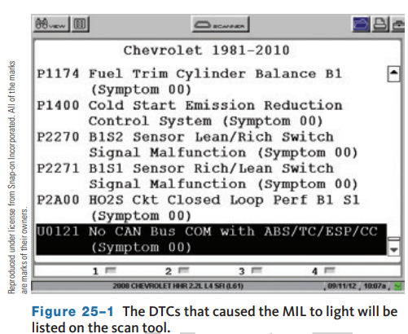
Using Scan Tool Data
25.01 Perform a scan tester diagnosis on various vehicles.
The engine control module (ECM) or PCM constantly monitors information from various switches, sensors, and other control modules.
It controls the operation of systems that affect vehicle performance and emission levels and monitors emission-related systems for deterioration.
OBD II monitors set a DTC when the performance of a system can cause elevated emissions.
The PCM also alerts the driver of emission-related concerns by illuminating the MIL.

Slide 5
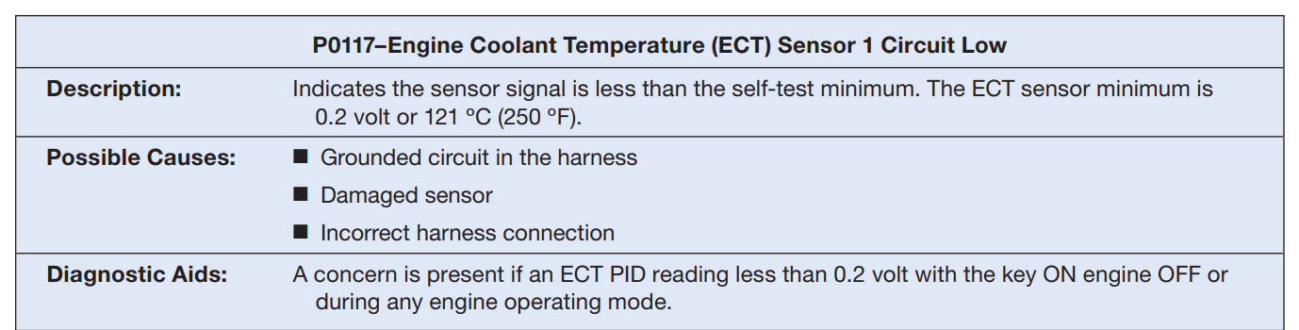
DTCs and Service Information
To access stored diagnostic trouble codes (DTCs), the scan tool requests data using Mode $03. Depending on the scan tool, a description of the DTC may be provided on the scan tool.
If the scan tool does not provide this information, you will need to find the details using the service information.
Check for current, pending, and history DTCs stored in memory. After retrieving the DTCs, find their descriptions in the service information.
Normally, the descriptions are followed by additional information to help diagnosis.

Slide 6
Freeze Frame Data
Freeze frame data associated with a DTC should also be retrieved.
This data contains values from specific generic PIDs that provide information about the operating conditions present when the code was set.
It can also be used to identify components that should be tested.
Misfire freeze frame (MFF) data contains some unique PIDs.
  MFF data is not part of freeze frame data that is stored with a DTC.
  It is used only for identifying the cause of a misfire.
Generic freeze frame data is also captured when a misfire occurs.
However, that data will not represent what happened at the time of the misfire; rather, it will show what happened after the misfire.
MFF data is captured at the time of the highest rate of misfire and not when the DTC is set.

Slide 7
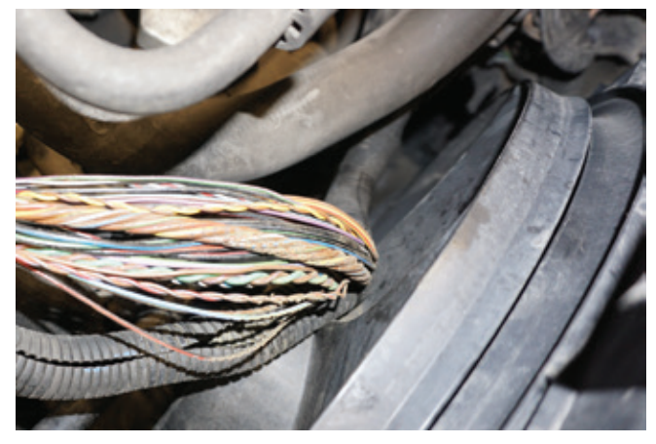
Mode $06 Data
The data available in Mode $06 can also be used to identify the cause of a concern.
Mode $06 allows access to the results of the various monitor diagnostic tests.
These values are stored when a specific monitor has completed a test. In addition to providing specific test results, Mode $06 data can be used to determine component condition and misfire rates.
In some cases, Mode $06 data can also help determine that a component is near failure.

Slide 8
Symptom-Based Diagnosis (1 of 2)
25.02 Conduct symptom-based diagnostics on an OBD II system.
Common Symptoms
  Repair manuals typically have a section dedicated to symptom-based diagnosis.
  Although a customer may describe a problem in nontechnical terms, you should summarize the concern to match one or more of the various symptoms listed by the manufacturer.
  Following are a few common driveability symptoms and a brief description of each:
    Hard Start/Long Crank Hard Start: Engine cranks OK, but it does not start unless it is cranked for a long time. Once running, it may run normally or immediately stall.
    No Crank: The starting system does not turn the engine over.
    No Start (Engine Cranks): The engine turns over normally but does not start even after a prolonged cranking
    Slow Return to Idle: When the accelerator pedal is released, it takes some time for the engine to return to its normal idle speed.

Slide 9
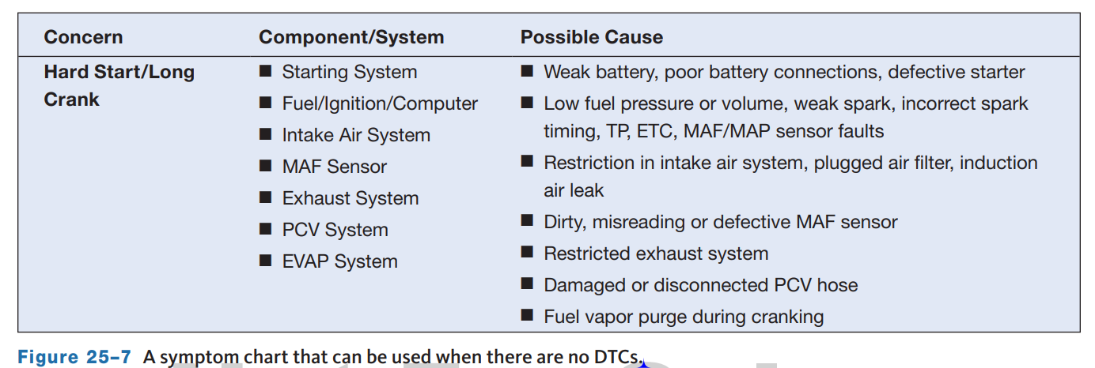
Symptom-Based Diagnosis (2 of 2)
Figure 25–7 is a symptom chart for common concerns that may not set a DTC and the component or system that could cause the problem.
Each potential problem area should be checked.
It is important to realize that some problems may cause more than one symptom.
In addition, remember to check if new software calibrations are available before attempting to solve a problem based on symptoms only.

Slide 10
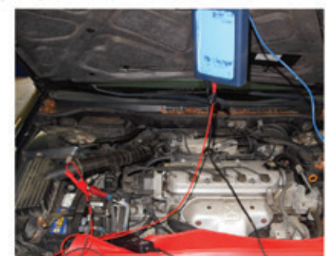
Testing Sensors
25.03 Perform basic tests on sensors.
If a DTC directs you to a faulty sensor or sensor circuit, or if you suspect a faulty sensor, it should be tested.
Always follow the procedures outlined by the manufacturer when testing sensors and other electronic components.
Also, make sure you have the correct specifications for each part tested.
Sensors are tested with a DMM, scan tool, and/or lab scope or GMM.
Software packages, often programmed in a lab scope or GMM, are available to help you properly interpret scope patterns and set up a lab scope.

Slide 11
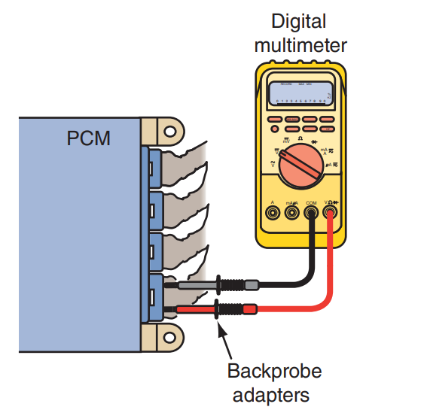
Diagnosis of Computer Voltage Supply and Ground Wires
25.04 Diagnose computer voltage supply and ground wires.
PCMs (OBD II and earlier designs) cannot operate properly unless they have good ground connections and the correct voltage at the required terminals.
A wiring diagram for the vehicle being tested must be used for these tests.
Backprobe the battery terminal at the PCM and connect a digital voltmeter from this terminal to ground.
Always use a good engine ground.

Slide 12
Switches
25.05 Test and diagnose switch-type input sensors.
Switches are turned on and off through an action of a device or by the actions of the driver.
Switches are either normally open or normally closed.
Switches send a digital signal to the PCM; they are either open or closed.
Some switches are provided with a reference voltage of 5 or 12 volts by the PCM.
Here are a few of the common grounding switches:
  Idle tracking switch
  Overdrive switch
  Clutch pedal position switch or power side switches
Here are a few of the common supply side switches:
  Ignition switch
  Park/neutral switch
  Air-conditioning (A/C) demand sensor

Slide 13
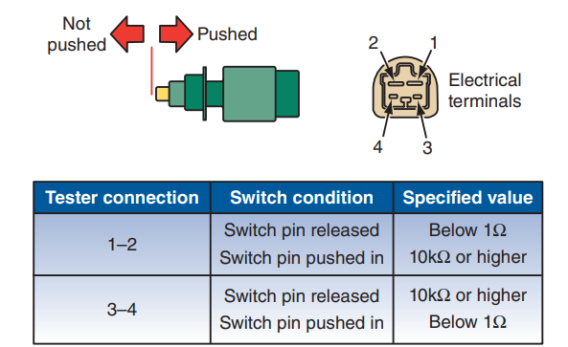
Testing Switches
A switch connected to a module can be tested by watching its status with a scan tool. Locate the data and activate the switch several times.
The PID should change state each time the switch is turned on and off.
A switch can be easily tested with an ohmmeter.
Disconnect the connector at the switch.
Refer to the wiring diagram to identify the terminals at the switch if there are more than two.
Connect the ohmmeter across the switch’s terminals.
Perform whatever action is necessary to open and close the switch.

Slide 14
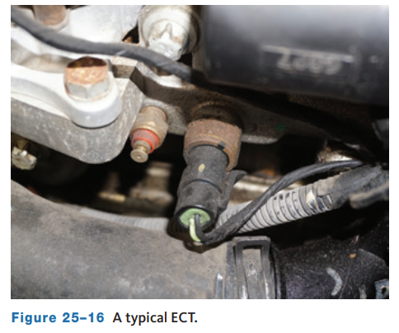
Engine Coolant Temperature (ECT) Sensor
The engine coolant temperature (ECT) sensor is a thermistor.
By measuring ECT, the PCM knows the average temperature of the engine.
Temperature is used to regulate many engine functions, such as the fuel injection system.
The ECT sensor is normally located in an engine coolant passage just before the thermostat.
A faulty ECT sensor or sensor circuit can cause a variety of problems.
The most common is the failure to switch to the closed-loop mode once the engine is warm.
ECT sensor problems are often caused by wiring faults or loose or corroded connections.

Slide 15
Pressure Sensors
Wheatstone bridges are used as variable resistance sensors.
These are typically constructed of four resistors, connected in series-parallel between an input terminal and a ground terminal.
Three of the resistors are kept at the same value, and the fourth is a sensing resistor.
When all four of the resistors have the same value, the bridge is balanced, and the voltage sensor will have a value of 0 volts.
If the sensing resistor changes value, a change occurs in the circuit’s balance.
The sensing circuit will receive a voltage reading proportional to the amount of resistance change.
If the Wheatstone bridge is used to measure temperature, temperature changes are indicated as a change in voltage by the sensing circuit.
Wheatstone bridges are also used to measure pressure (piezoresistive) and mechanical strain.

Slide 16
Knowledge Check (1 of 2)
A sensor that is a thermistor type and is normally located in an engine coolant passage is called the ____________.

Slide 17
Knowledge Check Answer (1 of 2)
  Answer: A sensor that is a thermistor type and is normally located in an engine coolant passage is called the Engine Coolant Temperature Sensor.

Slide 18
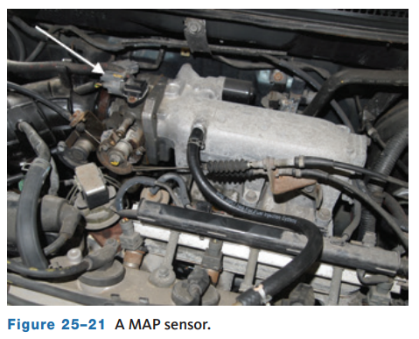
Manifold Absolute Pressure (MAP) Sensor
A manifold absolute pressure (MAP) sensor senses air pressure or vacuum in the intake manifold.
The sensor measures manifold air pressure against an absolute pressure.
The MAP sensor uses a perfect vacuum as a reference pressure.
The MAP sensor measures changes in the intake manifold pressure that result from changes in engine load, speed, and boost.
Engines with exhaust gas recirculation valves (EGR) that route exhaust gas into the intake manifold use the MAP sensor to monitor system performance.

Slide 19
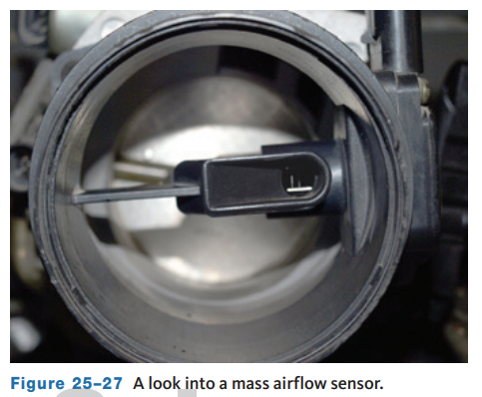
Mass Airflow (MAF) Sensors
The mass airflow (MAF) sensor measures the flow of air entering the engine.
This measurement of intake air volume is used to calculate engine load (throttle opening and air volume).
It is similar to the relationship of engine load to MAP or vacuum sensor signal.
The MAF typically also contains intake air temperature and humidity sensors.
There are different types of MAF sensors.
A commonly used design is the hot-wire MAF.

Slide 20
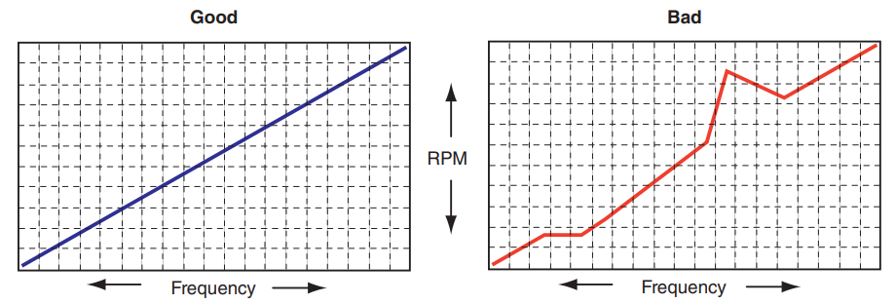
Testing a MAF Sensor
The test procedure for hot-wire MAF sensors varies with the vehicle make and year.
Some MAF sensors output a digital frequency signal.
To check, set the DMM so that it can read the frequency of DC voltage.
With it still connected to the signal wire and ground, the meter should read about 30 Hz with the engine idling.
Now increase the engine speed and record the meter reading at various speeds.
Graph the frequency readings.
The MAF sensor frequency should increase smoothly and gradually in relation to engine speed.

Slide 21
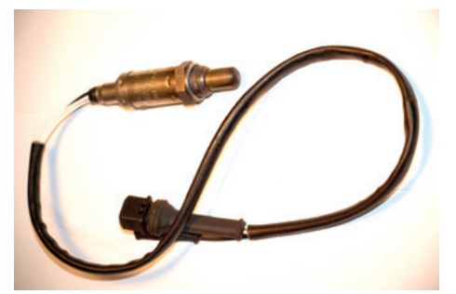
Oxygen Sensors
The exhaust gas oxygen sensor (O₂S) or air–fuel ratio sensor, is the key sensor in the closed-loop mode.
The O₂S is threaded into the exhaust manifold or into the exhaust pipe near the engine.
The PCM uses an O₂S to ensure that the air–fuel ratio is correct for the catalytic converter.
The PCM adjusts the amount of fuel injected into the cylinders based on the O₂S signal.
OBD II standards require an O₂S before and after the catalytic converter.

Slide 22
Heated Oxygen Sensors
To generate an accurate signal, an O₂S must operate at a minimum temperature of 750 ºF (400 ºC).
Current O₂S have a built-in heating element to quickly heat them and keep them hot at idle and light load conditions.
The heater is controlled by the PCM.
Early O₂S did not have a heater and required some time for the exhaust to warm them.
Heated oxygen sensors (HO₂S) have three or four wires connected to them.
The additional wires provide voltage for the internal heater in the sensors.
HO₂S are sometimes referred to as heated exhaust gas sensors (HEGOs).
The PCM controls the ground for the heater circuit as needed.
The cycling of current to the heater protects the ceramic material of the heater from being overheated, which would cause it to break.

Slide 23
Checking Oxygen Sensors and Circuits
Common causes of abnormal O₂S operation include incorrect fuel pressure, a malfunctioning AIR system, an EGR leak, a leaking injector, a vacuum leak, an exhaust leak, and a contaminated MAF sensor.
It is important to determine if it is the O₂S itself or some other factor that is causing the O₂S to behave abnormally.
The accuracy of the O₂S reading can be affected by air leaks in the intake or exhaust manifold.
A misfiring spark plug that allows unburned oxygen to pass into the exhaust also causes the sensor to give a false lean reading.
An O₂S can be contaminated and become lazy.
Lazy is a term used to describe a common symptom; it takes a longer-than-normal time for the sensor to switch from lean to rich or rich to lean.
A contaminated sensor may stop switching and provide a continuously low or high signal as well.

Slide 24
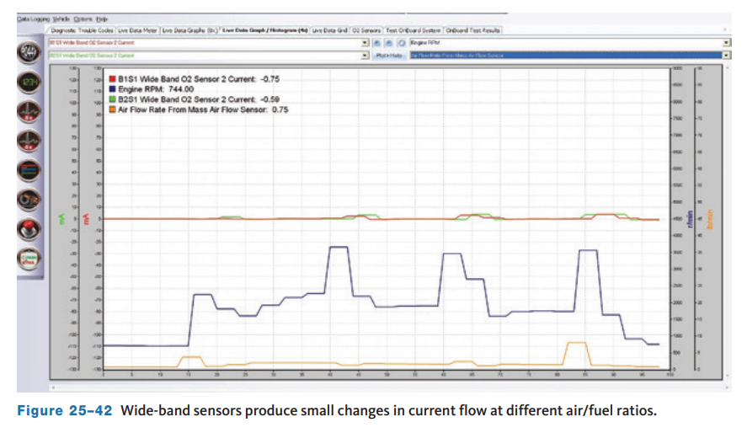
Testing Air–Fuel Ratio (A/F) Sensors
A/F sensors cannot be tested in the same way as an O₂S.
The A/F sensor has two signal wires.
The PCM supplies 3 volts to one wire and 3.3 volts to the other.
If a voltmeter is connected across these two wires, the difference in potential will be measured.
This reading has no meaning because the 0.3-volt difference will always be there regardless of the oxygen content.
The heater circuit can be checked with a voltmeter, and the heater can be checked with an ohmmeter.

Slide 25
Discussion
Oxygen sensors are not effective at measuring exhaust oxygen content until warped up.
Have a class discussion about what temperature needs to be reached, how the temperature is reached, and what happens once the sensor is warmed up.

Slide 26
Position Sensors
25.06 Test and diagnose variable resistance-type input sensors.
Position sensors are used to monitor the position of something from totally closed to totally open positions.
They are basically potentiometers.
A wiper arm is connected to a moving part on one end, and the other end is in contact with a resistor; the resistor is supplied with a reference voltage.
As the part moves, so does the wiper arm.
As the wiper arm moves on the resistor, the voltage changes and the available voltage at the point where the wiper arm contacts the resistor is the signal voltage sent to the PCM.
The PCM then interprets the part’s position according to the voltage.

Slide 27
Position Sensors
25.06 Test and diagnose variable resistance-type input sensors.
Reference Voltage Sensors
To get an exact look at what is happening in a system, the computer sends a constant, predetermined voltage signal to a sensor. The sensor reacts to operating conditions and sends a voltage signal back to the computer. This type of sensor is called a reference voltage (Vref) sensor. The voltage sent out by the computer is called the reference voltage and normally has a value of 5 to 9 volts. The reference voltage is sent out to a sensor through a reference voltage regulator in the computer. The regulator keeps the reference voltage at a predetermined value. Because the computer knows that a certain voltage value has been sent out, it can indirectly interpret things like motion, temperature, and component position, based on what comes back. Most reference voltage sensors are variable resistors or potentiometers. They modify the reference voltage and the return voltage represents a condition. The computer will use the return voltage to calculate the condition and order changes to system operation, if necessary

Slide 28
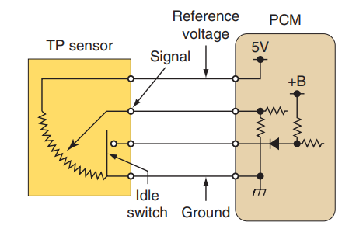
Throttle Position (TP) Sensor
Throttle position (TP) sensors send a signal to the PCM regarding the rate of throttle opening and the relative throttle position.
The wiper arm in the sensor is rotated by the throttle shaft .
As the throttle shaft moves, the wiper arm moves to a new location on the resistor.
The return voltage signal tells the PCM how much the throttle plates are open.
As the signal tells the PCM that the throttle is opening, the PCM enriches the air–fuel mixture to maintain the proper air–fuel ratio.

Slide 29
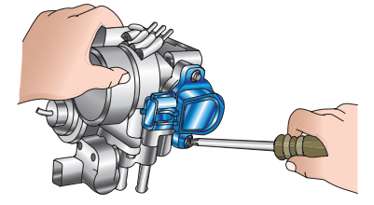
Testing a TP or APP Sensor
Follow these steps to adjust a typical TP sensor:
  Backprobe the TP sensor signal wire and connect a voltmeter from this wire to ground.
  Turn on the ignition switch and observe the voltmeter reading with the throttle in the idle position.
  If the TP sensor does not provide the specified voltage, loosen the TP sensor mounting bolts and move the sensor housing until the specified voltage is indicated on the voltmeter.
  Hold the sensor in this position and tighten the mounting bolts to the specified torque.

Slide 30
Position and Speed Sensor Types
Position sensors are used to detect the precise position of something, such as crankshafts and camshafts, while speed sensors measure the rotational speed of something.
Sometimes, a sensor does both, such as with the crankshaft position sensor.
The PCM uses these signals in a number of ways, depending on the system.
There are three commonly used sensor types: magnetoresistive sensors, permanent magnet pulse generators (PM generators), or Hall-effect switches/sensors.
Identifying the type of sensor used in a particular application dictates how the sensor should be tested.
Magnetoresistive (MR) sensors and PM generators are similar in appearance, to magnetic pulse generators, each having only two wires, but differ in operation. MR sensors have two wires, one for reference voltage supplied to the sensor and the other is a signal return wire.

Slide 31
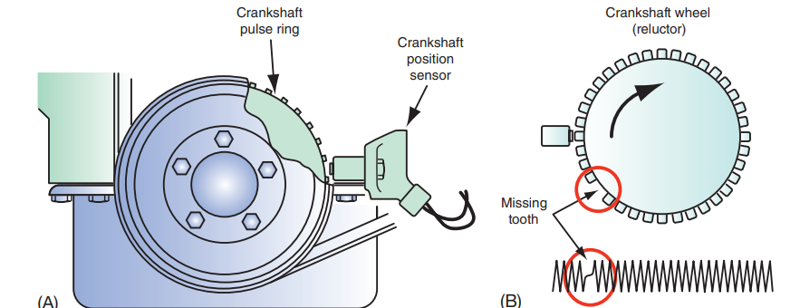
Crankshaft Position (CKP) Sensor
The rotor for a crankshaft position (CKP) sensor has several teeth (the number varies with application) equally spaced around the outside of the rotor.
One or more teeth are missing at fixed locations.
These missing teeth provide a reference point for the PCM to determine crankshaft position.
Input from the CKP is critical to the operation of the ignition system.
This input is also used by the PCM to help determine if a misfire has occurred.

Slide 32
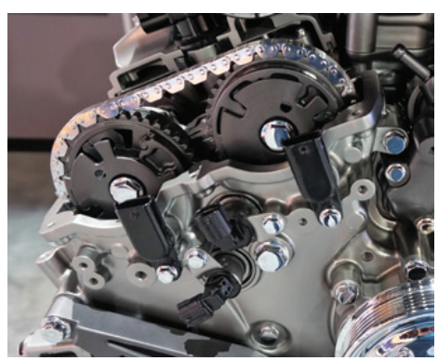
Camshaft Position (CMP) Sensors
The camshaft position (CMP) sensors monitor the position of the camshafts.
The CMP’s output is used with the CKP to determine when cylinder number 1 is on its compression stroke.
This information is used for control of the fuel injection, direct ignition, and variable valve timing systems.
Engines with variable valve timing typically have two CMPs, one for each engine bank.
On some engines, a bad CMP will prevent the misfire monitor from completing.
CMP sensors can be magnetic pulse generators or Hall effect.

Slide 33
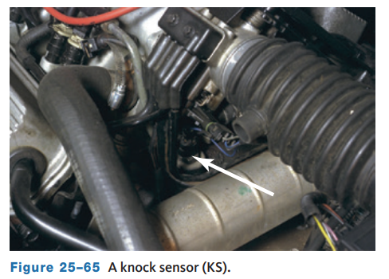
Knock Sensor (KS)
The knock sensor (KS) tells the PCM that detonation is occurring in the cylinders. In turn, the computer retards the timing.
The KS is a piezoelectric device that works like a microphone and converts engine knock vibrations into a voltage signal.
Piezoelectric devices generate a voltage when pressure or a vibration is applied to them.
Engine knock typically is within a specific frequency range, and a KS is set to detect vibrations within that range.
The KS is located in the engine block, cylinder head, or intake manifold.

Slide 34
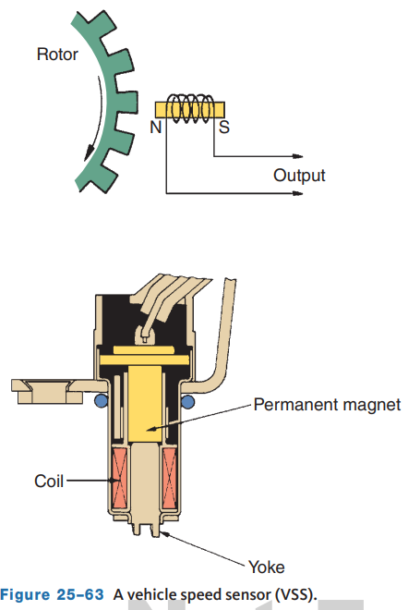
Vehicle Speed Sensor (VSS)
The most common vehicle speed sensor (VSS) is a magnetic pulse generator (variable reluctance) sensor.
However, some use a Hall-effect switch.
A VSS generates a waveform at a frequency that is proportional to the vehicle’s speed.
When the vehicle is moving at a low speed, the sensor produces a low-frequency signal.
As vehicle speed increases, so does the frequency of the signal.
The PCM uses the VSS signal to help control the injection system, ignition system, cruise control, EGR flow, canister purge, transmission shift timing, variable steering, and torque converter clutch lock-up timing.

Slide 35
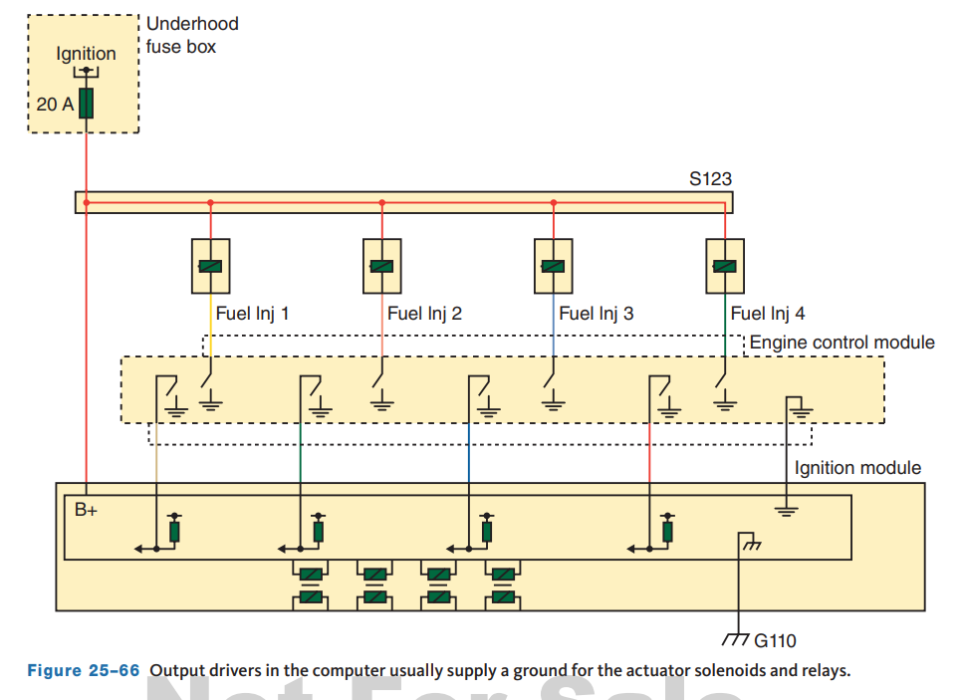
Computer Outputs and Actuators
Actuators are electromechanical devices that convert an electrical current into mechanical action.
This mechanical action can then be used to open and close valves, control vacuum to other components, or open and close switches.
When the PCM receives an input signal indicating a change in one or more of the operating conditions, the PCM determines the best strategy for handling the conditions.
The PCM then controls a set of actuators to achieve a desired effect or strategy goal.
In order for the computer to control an actuator, it must rely on a component called an output driver.

Slide 36
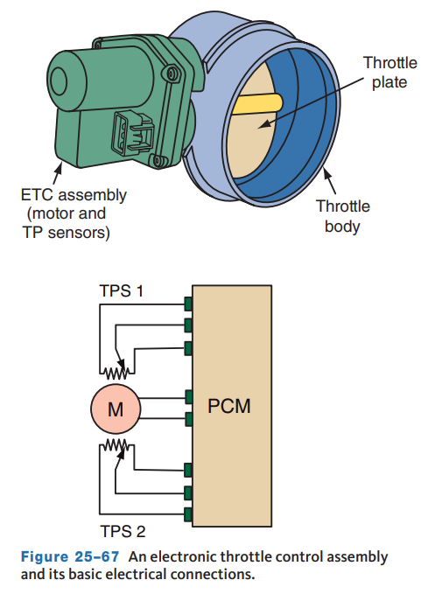
Electronic Throttle Control
Like modern aircraft, the acceleration on some late-model vehicles works on the “drive-by-wire” principle, which is typically called electronic throttle control (ETC).
ETC interprets gas pedal movement by the driver and allows for precise throttle control, which helps to improve fuel economy and performance while reducing emissions.
Instead of a throttle cable and mechanical linkage to the throttle body, the connection is made through wires.

Slide 37
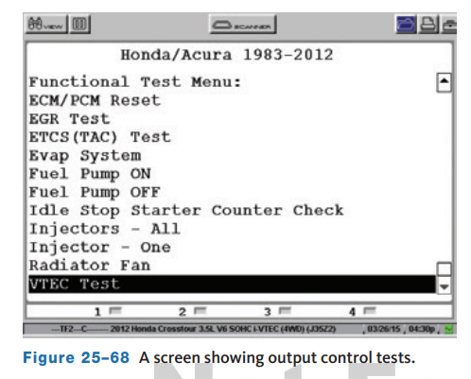
Testing Actuators
25.08 Test and diagnose output devices (actuators).
Most systems allow for testing the actuator through a scan tool.
Actuators that are duty cycled by the computer are more accurately diagnosed through this method.
Prior to diagnosing an actuator, make sure the engine’s compression, ignition system, and intake system are in good condition.
Serial data can be used to diagnose outputs using a scanner.
The displayed data should be compared against specifications to determine the condition of any actuator.

Slide 38
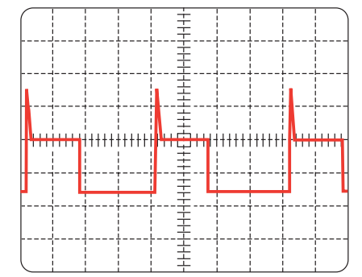
Testing Actuators with a Lab Scope
When actuators are faulty, it is because they are electrically faulty or mechanically faulty.
By observing the action of an actuator on a lab scope, you will be able to watch its electrical activity.
Normally if there is a mechanical fault, this will affect its electrical activity as well.
Therefore, you get a good sense of the actuator’s condition by watching it on a lab scope.
To test an actuator, you need to know what it basically is.
Most actuators are solenoids.
The computer controls the action of the solenoid by controlling the pulse width of the control signal.

Slide 39
Knowledge Check (2 of 2)
What is the most common method for testing an actuator?

Slide 40
Knowledge Check Answer (2 of 2)
Most systems allow for testing the actuator through a scan tool.
Actuators that are duty cycled by the computer are more accurately diagnosed through this method.

Slide 41
Repairing the System
After isolating the source of the problem, the repairs should be made.
The system should then be rechecked to verify that the repair took care of the problem.
This may involve road testing the vehicle in order to verify that the complaint has been resolved.
When servicing or repairing OBD II circuits, here are a few of the important guidelines to follow:
  Do not connect aftermarket accessories into an OBD II circuit.
  Do not move or alter grounds from their original locations.
  Always replace a relay in an OBD II circuit with an exact replacement. Damaged relays should be thrown away, not repaired. Make sure all connector locks are in good condition and are in place.
  After repairing connectors or connector terminals, make sure the terminals are properly retained and the connector is sealed.

Slide 42
Chapter Reflection
Please take a moment to compare your understanding of detailed diagnosis and sensors. Then respond to the following questions in one or two paragraphs. Use 150–200 words in your reflection.
Did you feel you struggled to understand any of the sensors in this chapter? Which sensors were the most difficult to understand?
Considering all you have learned, do you feel prepared to diagnose and repair these systems in the lab or shop? How can you become more prepared?

